Slide 1
Critical Thinking & IT Concepts
Week 1 - Introduction

Slide 2
Evaluation
No late assignments will be accepted after deadline!
Passing mark for this course is 50
Evaluation Breakdown
Tests | 24%
Labs and Assignments | 76%
Total | 100%

Slide 3
Objectives
Components of a computer system: -
Hardware and Software
Introduction to Data Processing
Importance of Data Processing to Organizations: Effect on - profitability, customer service, management
Use of computers for data processing.

Slide 4
What makes a computer
What makes a computer
https://www.youtube.com/watch?v=mCq8-xTH7jA&feature=youtu.be
Computer Hardware and Software
https://www.youtube.com/watch?v=xnyFYiK2rSY
CPU, Memory, Input & Output
https://www.youtube.com/watch?v=MMzdKTtUIFM

Slide 5
Important Links
What is inside a computer?
https://www.gcflearnfree.org/computerbasics/inside-a-computer/1/

Slide 6
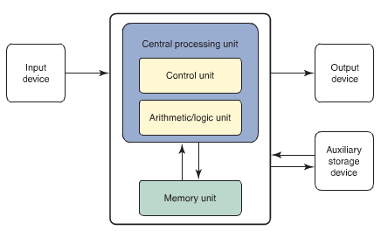
Basic components of a computer

Slide 7
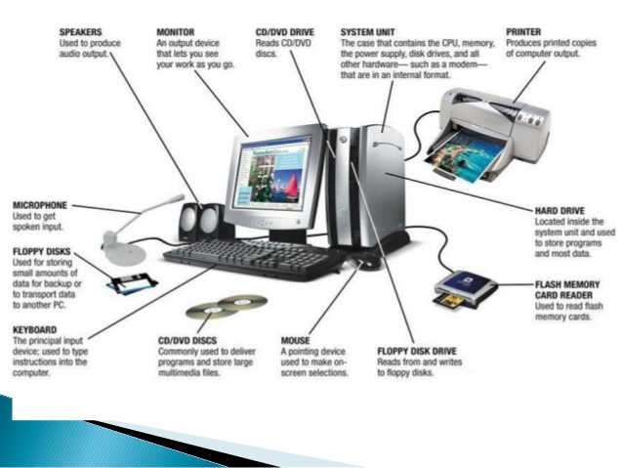
COMPUTER SYSTEM
A complete, working computer. Computer systems will include the computer along with any software and peripheral devices that are necessary to make the computer function. Every computer system, for example, requires an operating system

Slide 8
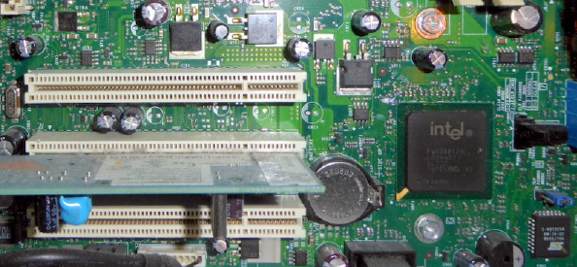
Hardware
Computer hardware is built by placing and assembling electronic components onto circuit board

Slide 9
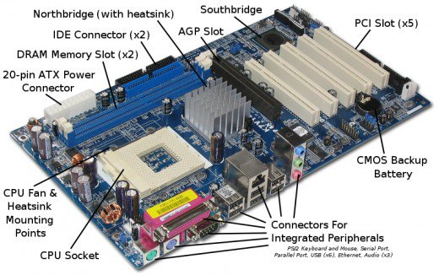
Hardware

Slide 10
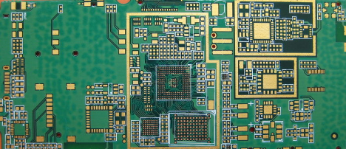
Hardware
Circuit board on phone

Slide 11
CPU
Central Processing Unit (CPU): The part of the computer that executes the instructions stored in memory. It controls all other components’ operations and makes all the decisions.
Many computers use Intel processor chip for the CPU.
Smartphones and tablets use smaller CPU chip.
CPU needs two items: code and data
Code or program is the list of instructions that tells the computer what to do.
Data is information that a program processes

Slide 12
CPU
“Registers” in the CPU hold the data on which computations are performed.
Because they are very expensive to build so computers don’t have many.
As a result a lot of computer’s operations use memory to hold data
Operations are performed by copying data from memory into a register → data is processed → copy the result back to memory

Slide 13
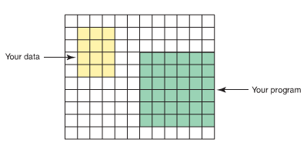
Hardware
Memory Unit: Internal data storage in a computer
The memory unit is an ordered sequence of storage cells, each capable of holding a piece of data.
Each memory cell has a distinct address to which we refer to store data into it or retrieve data from it. These storage cells are called memory cells, or memory locations.
The memory unit holds data and instructions.

Slide 14
Hardware
On a laptop, you might have 8GB of memory but 1TB of storage
Memory is very fast and expensive too
Generally RAM is referred as memory but there are various types of memories
When power is turned off, all information in memory disappears
Phones use flash memory for storage instead of HDD. Flash memory is less prone to failure than hard disk since it does not have moving parts.

Slide 15
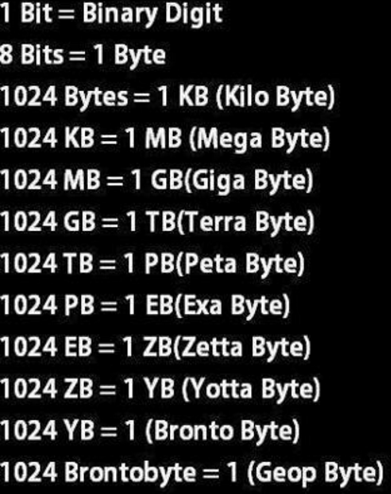
Memory measurement units

Slide 16
Hardware
Input/output (I/O) devices: Accept data to be processed (input) and present processed data (output). Common input devices - keyboards, mouse, and scanner. Common output devices - printers and liquid crystal display (LCD) screens.
Peripheral device: An input, output, or auxiliary storage device attached to a computer
Auxiliary storage device: A device that stores data and programs in encoded form outside the computer’s main memory like, disk drives. The data on the hard disk is preserved even when the computer is shut down.

Slide 17
Software
Software is referred to the set of programs used to direct the operations of computer.
OR
The set of programs that simplifies the user/computer interface and improves the efficiency of processing is called system software. It includes the JVM and the Java compiler as well as the operating system and the editor

Slide 18
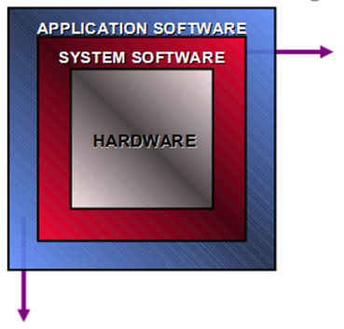
Software
Operating System:
Schedules computer events
Allocates computer resources
Monitor events
Language Interpreters:
Interpreters
Compilers
Utility Programs:
Routine Operations
Manage Data
Programming Languages:
Assembly, C#, Java, C++

Slide 19
Software
OS controls computer hardware
When you turn on the computer, the very first task that is performed is, the OS is copied from hard disk into memory.
Familiar OS:
Microsoft Windows and Mac for PCs
Linux for servers
Apple iOS or Google Android for phones
Once the OS is running, you can run other applications on laptops or apps on phones.

Slide 20
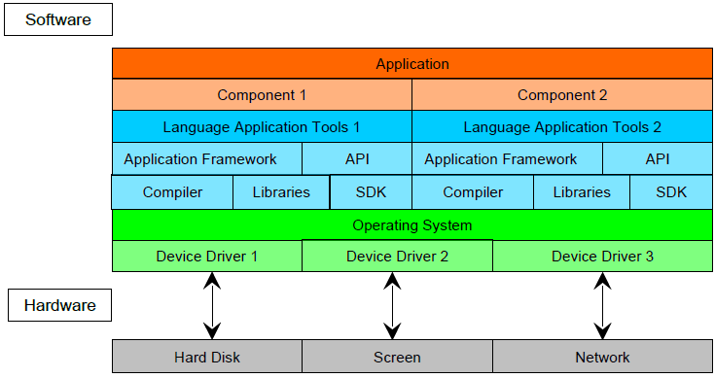
Software

Slide 21
Software
Application or app is developed for a particular use and is the top most layer
Application tools are general purpose tools. Some are particular to each programming language like compiler.
Application Framework provides predefined code and templates for the programming language
API i.e. “Application Programming Interface” provides a software interface to other third party software running on another computer

Slide 22
Software
Libraries provide software that can be called by the application
Compiler translates particular programming language into machine code
SDK is software development kit. SDK has to be added to the tool set to provide an interface to a particular OS as many capabilities of the OS may not be available in a standard library
Device driver is software that allows OS’s communication with the hardware device

Slide 23
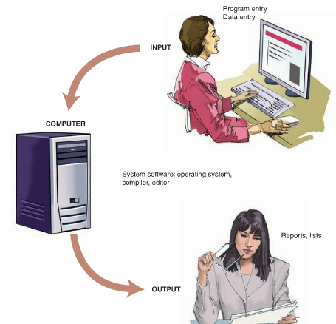
User/Computer Interface

Slide 24
Data and Information
Data: Data is a collection of unprocessed items which can include letters, words, integer numbers, real numbers, date, times, coordinates on a map, and so on.
Information: Any knowledge that can be communicated
Computers manipulate data to create information.
Computer programming requires us to write very simple, exact instructions that consist only of operations that a computer can perform.
The World Wide Web is an example of a vast store of information, which can be searched.

Slide 25
Use of Computers for Data Processing
Data Processing – A way in which data transactions are grouped and handled for input to the central processor for computation or generation of reports and outputs.
A computer can input (accept) data from an input device (a keyboard or mouse, for example) and output (send) data to an output device (a screen, for example).
A computer can store data into and retrieve data from its memory and secondary storage.

Slide 26
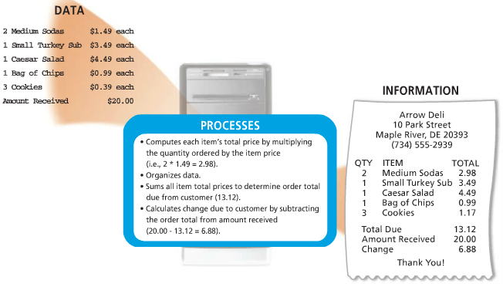
A computer processes data into information. In this simplified example, the item ordered, item price, quantity ordered, and amount received all represent data. The computer processes the data to produce the cash register receipt (information).

Slide 27
Data Processing Stages
Data Input
Data Storage
Data Processing
Information Output

Slide 28
Data Processing
All data processing tasks require data values to be loaded into RAM before we can perform calculations on the data values.
Different processing tasks will require the data values to be organized and stored in different ways.
Various data structures used are Arrays, Lists, trees, Maps etc.

Slide 29
Methods of Data Processing
Batch Processing: This is a method where the information to be organized is sorted into groups to allow for efficient and sequential processing. Data is accumulated at regular intervals for a predetermined period of time after which it is processed to produce the desired output. Like the way that credit card companies process billing; payrolls etc.
Online Processing: This is a method that utilizes Internet connections and equipment directly attached to a computer. Data is processed immediately while it is entered, the user usually only has to wait a short time for a response. (ex. games, booking systems, banking systems).

Slide 30
Methods of Data Processing
Real-Time Processing: This technique has the ability to respond almost immediately to various signals in order to acquire and process information. Example is traffic control system.
Distributed Processing: This method is commonly utilized by remote workstations connected to one big central workstation or server. ATMs are good examples of this data processing method.

